Slide 1
Final Project Presentation
Diogo de Abreu Ribeiro

Slide 2
Introduction
The goal of this project was to create an OutSystems Style Guide for a new client, MediaWeb, using Rocket UI, OutSystems itself, SCSS, and architectural best practices, based on a design created in Figma, putting into practice everything I learned during the ramp-up.

Slide 3
Installing RocketUI
We start by going to the “OS” Forge to download RocketUI and its style guide, then we create our theme and link it to the RocketUI style guide, because we’re going to use the OutSystems style guide—which has already been modified in some parts by RocketUI—and on top of that, we’ll apply our own changes to layouts, patterns, and widgets; we can modify everything.
It might be a beginner’s mistake, but I ran into some trouble with the dependencies because I thought that when installing the necessary dependencies on the Forge, everything would come along with it, but we don’t have to install them one by one.

Slide 4
Project Organization
In RocketUI, there are patterns and a theme; we use the patterns within the layouts and in the theme.
In the RocketUI style guide, we have Rocket templates, assets from Outsystems and Rocket, a database, and the style guide page.
Later, I created the Mediaweb Theme, which is my client that uses RocketUI; in my theme, I have my patterns, resources, and theme.

Slide 5
Assembly
Once that’s done, we’ll move on to customizing the OutSystems widgets, styling them as shown in the style guide (Customize all Built-in Widgets)
Once we had the entire system set up and were ready to start making changes for the client, I began developing my root and utility classes by analyzing the Figma files, adding and modifying only what was strictly necessary (Foundations).

Slide 6
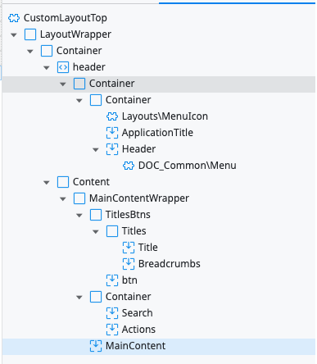
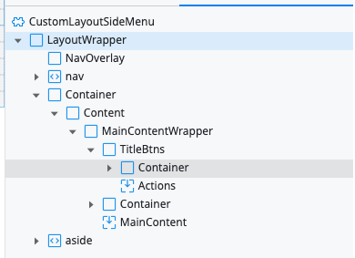
Assembly
I then moved on to developing custom layouts for the project, where I cloned the Rocket template and modified it to match Figma, applying styles so that when a developer drags a widget into it, it would be immediately positioned in the right place with the correct spacing and alignment. Here are some examples of their widget trees:

Slide 7
Assembly
In addition to the widgets I created, there were a few others that weren’t in the style guide, so I ended up having to style a few more, and I tested the layouts to make sure everything fit properly and didn’t take up empty space.
For example, some buttons and the breadcrumbs.

Slide 8
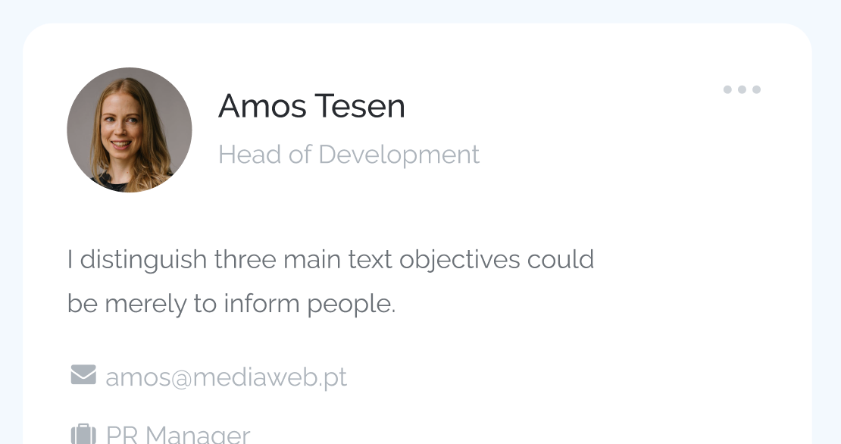
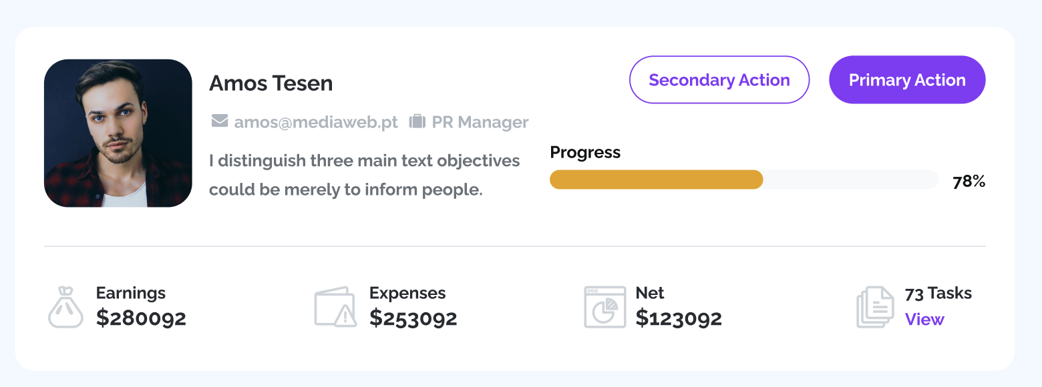
Assembly
We moved on to creating the patterns. What gave me the most trouble at the time was the card, because there are two cards in the project, and with only three placeholders, I wanted to make a single pattern work for both cards—which was going to be very difficult. It actually worked, but the content didn’t end up in the right place. I ended up creating more placeholders, as expected, styled them, and eventually created input parameters that specify which card to use.

Slide 9
Assembly
As I was putting the screens together here, I added the components I had developed and ended up finding some issues with certain components that I had to fix. In other words, I ended up not only assembling the screens but also correcting or adding styles to things I had done previously.
I’ll show you some examples in the following slides:

Slide 10
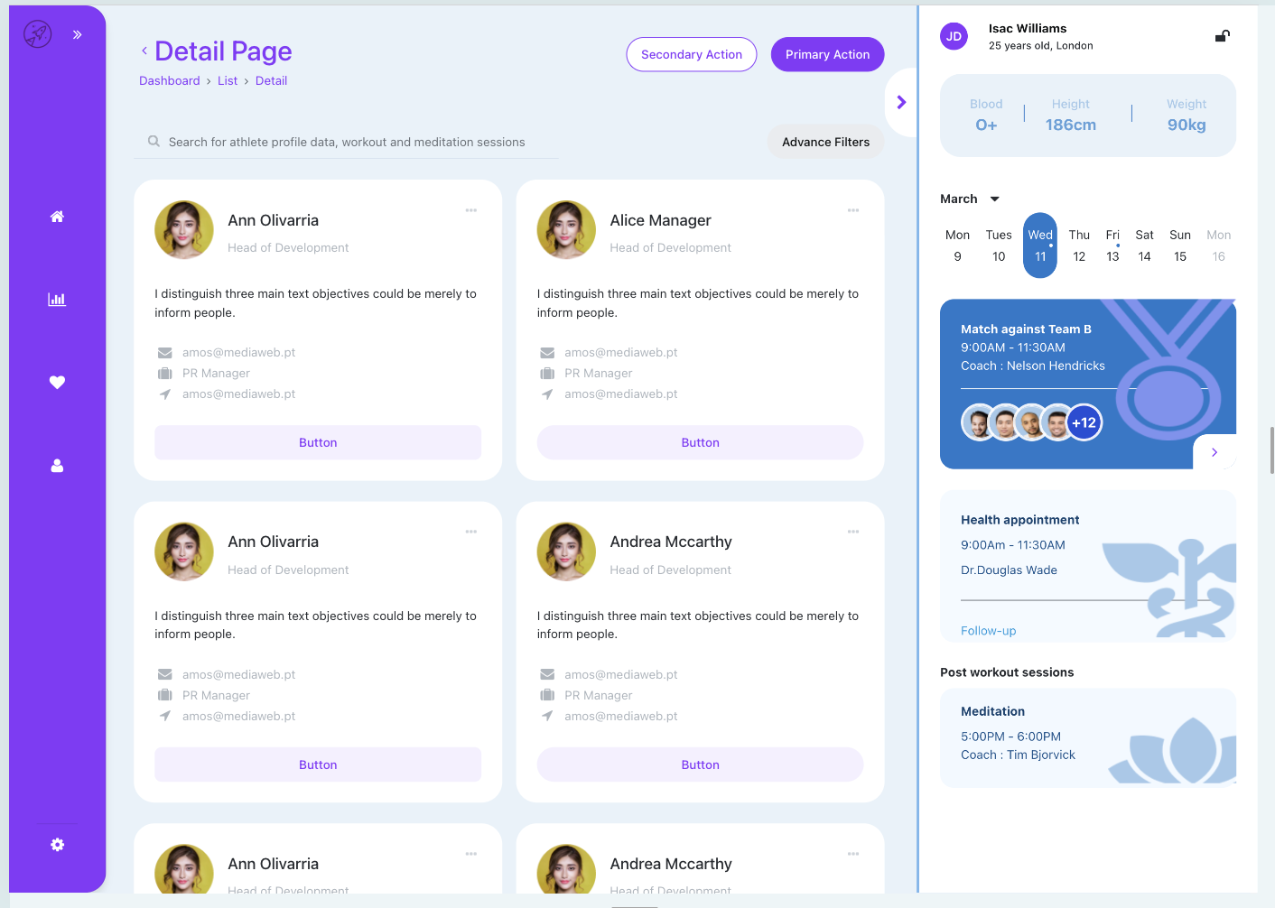
Assembly
Employess Gallery:

Slide 11
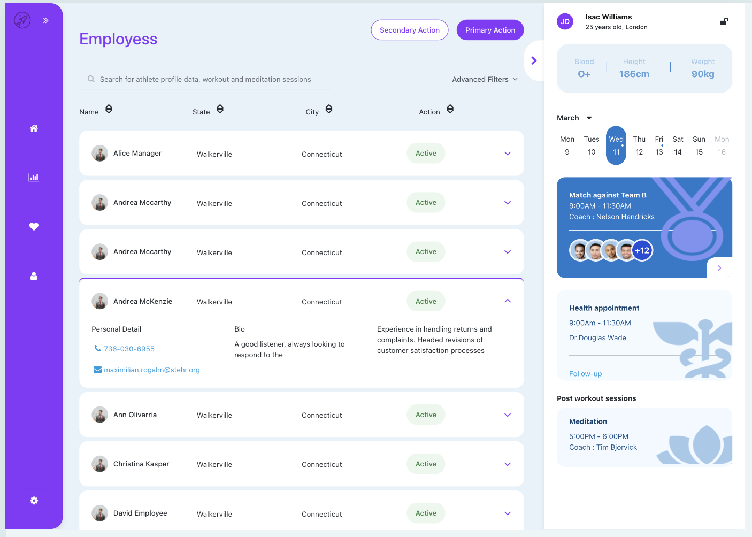
Assembly
Employess List:

Slide 12
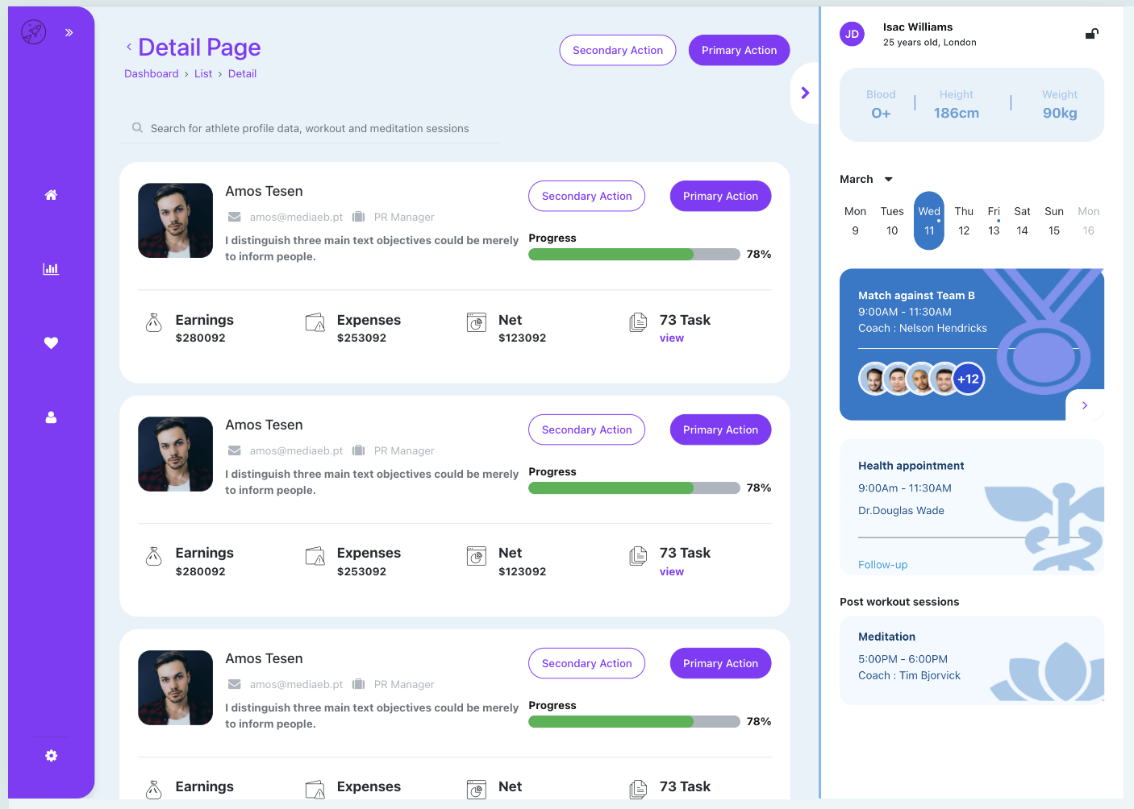
Assembly
Employess Card:

Slide 13
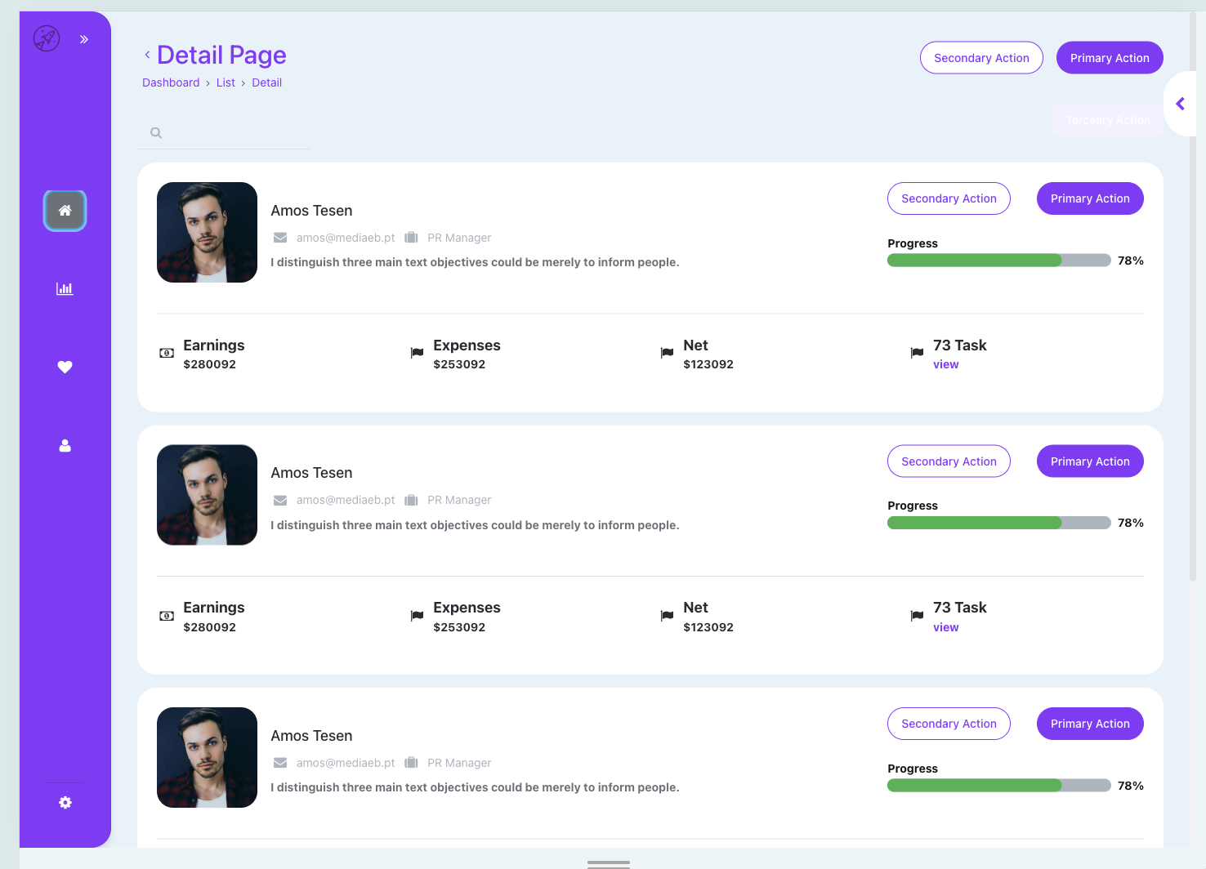
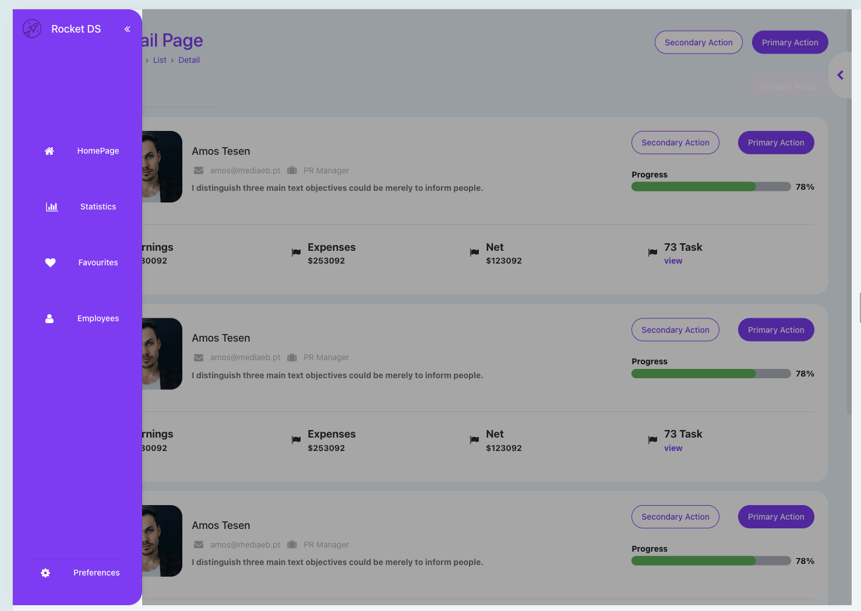
Assembly
Sides open/closed :

Slide 14
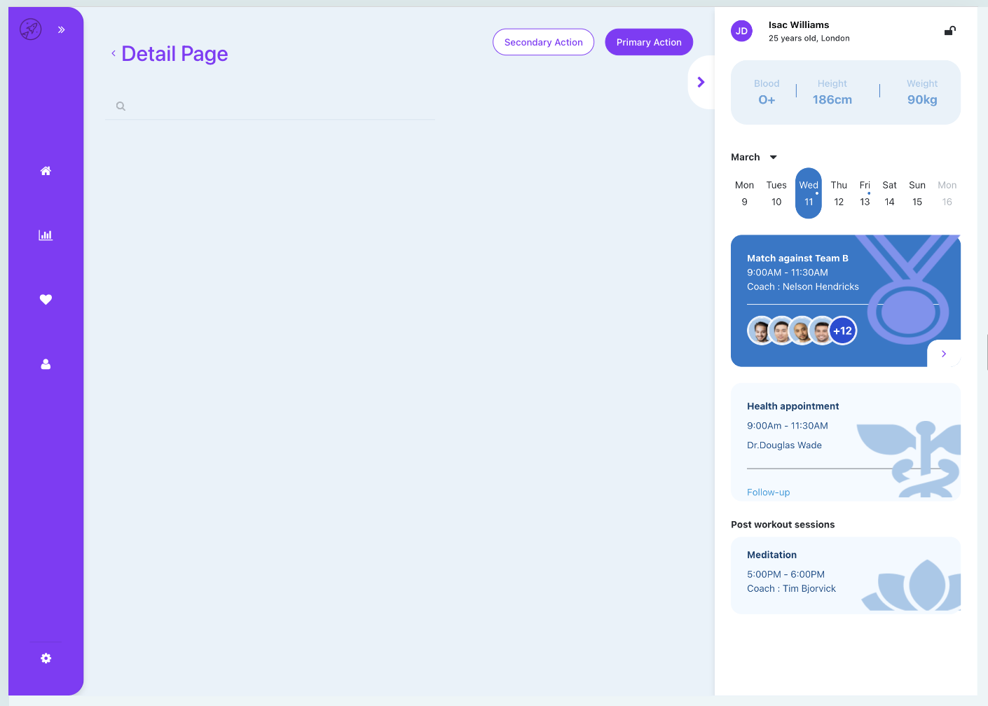
Template
Side nav + sidebar Template

Slide 15
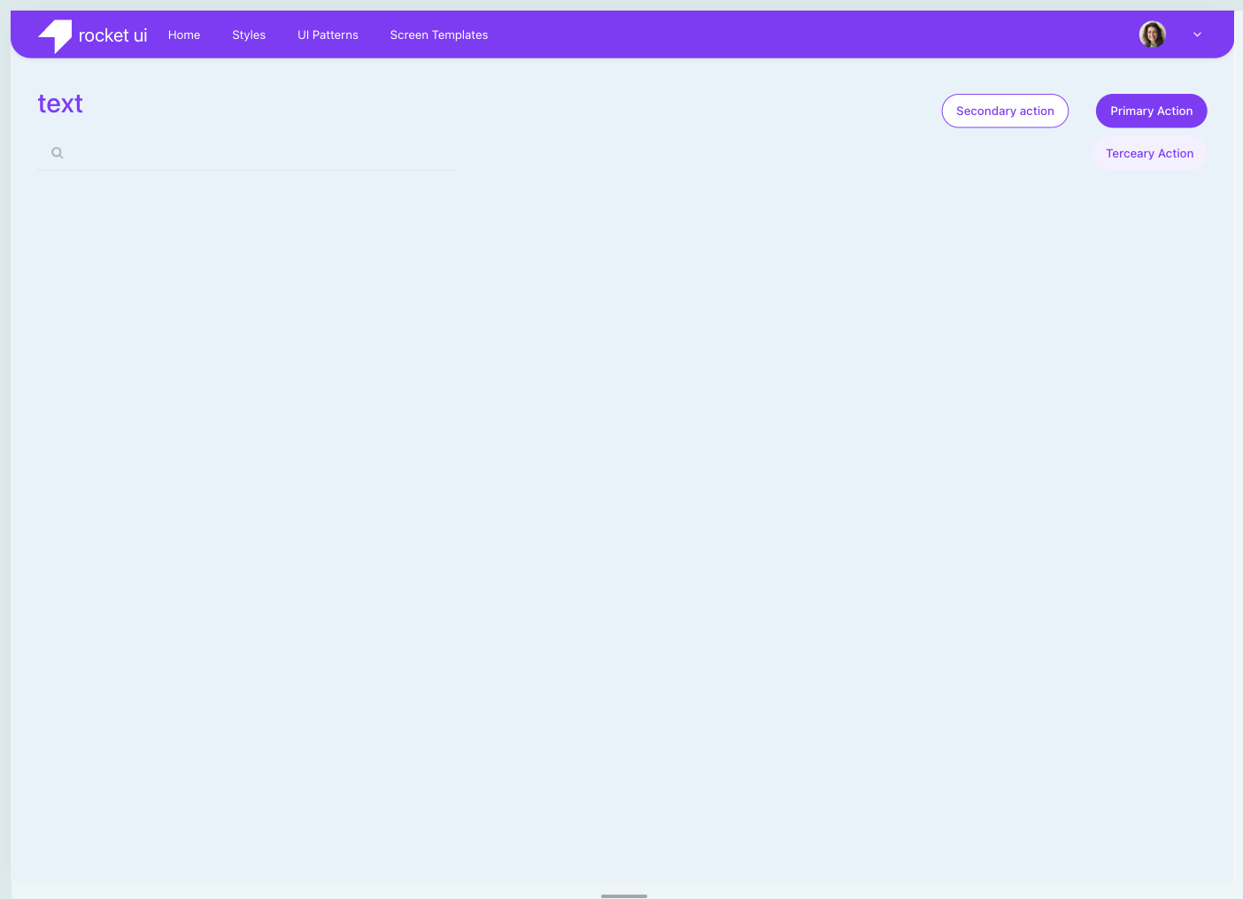
Template
Top nav:

Slide 16
Documentation
If i have any questions, I spoke with my team leader, André Henriques, and with Diogo Miranda, the mentor.
1
https://doitlean-dev.outsystemscloud.com/RocketUI/
2
https://success.outsystems.com/documentation/11/building_apps/user_interface/screen_templates/creating_screen_templates/ (Templates)
3
https://www.youtube.com/watch?v=2wEQcbIM_h8&t=2886s (Templates)
4
ChatGpt , Gemini;
5

Slide 17

Final conclusions
I ran into some challenges, but I managed to overcome them. I gained a better understanding of how to work on a real-world project and how both Rocket’s style guide and our own can be beneficial—so that we only have to do things once, and so that the project remains cleaner and more scalable in case the client wants to make even a minor change.

